Slide 1
M&A Integration
End State Examples
Defining What Integration Success Looks Like
100-DAY ADVISORS

Slide 2
What Are End States?
End states define what success looks like once integration is complete for shareholders, customers, vendors, and employees. They turn a high-level deal thesis into tangible outcomes that teams can aim for, design around, and measure.
💰
🤝
📦
👥
Shareholders
Customers
Vendors
Employees
Early, clear definition of end states enables aligned work plans and better day-to-day trade-offs.
© 100-Day Advisors MandAPlaybook.com
2

Slide 3
Shareholder End States
Guiding Questions
Illustrative Examples
What financial and strategic outcomes must the combined company deliver (e.g., synergy realization, margin expansion, improved earnings, or stronger TSR)?
How should the market, analysts, and owners understand the new equity story once integration is complete?
Within 24 months, the combined business delivers the majority of promised cost and revenue synergies in line with or ahead of the original deal case.
The earnings profile improves: a greater portion of profit comes from recurring, diversified, and scalable revenue streams, reducing volatility versus the pre-merger company.
KEY METRICS TO TRACK
Synergy Realization %
EBITDA Margin
Revenue Mix
Total Shareholder Return
© 100-Day Advisors MandAPlaybook.com
3

Slide 4
Customer End States
Guiding Questions
Illustrative Examples
What should customers experience during and after integration (e.g., no service disruption, simplified terms, and a broader, integrated product set)?
How will relationships be managed — single relationship owner, unified service model, and consistent service levels across the combined organization?
One year after close, customer satisfaction and NPS meet or exceed pre-deal levels, and attrition among strategic accounts is stable or improving.
Customers interact through a unified digital front door — a single portal covering ordering, billing, and support instead of multiple legacy systems.
KEY METRICS TO TRACK
NPS Score
Account Attrition Rate
Support Ticket Volume
Portal Adoption %
© 100-Day Advisors MandAPlaybook.com
4

Slide 5
Vendor & Partner End States
Guiding Questions
Illustrative Examples
How will the combined company manage its vendor base (e.g., consolidated contracts, standardized commercial terms, and clearer performance expectations)?
Which partners are truly strategic, and how will they be managed under a single relationship and governance model?
The majority of external spend is managed through a streamlined vendor set, with consolidated agreements, common terms, and harmonized performance standards.
Key strategic partners operate under one integrated relationship model, with shared account plans and a single governance cadence (e.g., quarterly business reviews).
KEY METRICS TO TRACK
Vendor Count Reduction
Spend Under Management
Contract Consolidation %
Strategic Partner Reviews
© 100-Day Advisors MandAPlaybook.com
5

Slide 6
Employee End States
Guiding Questions
Illustrative Examples
What should day-to-day work feel like once integration is complete (e.g., clear org structures, unified culture, common tools, and harmonized HR programs)?
How will employees be connected to the new organization — shared brand, common platforms, a single intranet, and clear performance and reward frameworks?
All employees follow a unified performance management approach, including aligned cycles, rating scales, goal-setting, and incentive design, allowing for local market differences.
A single leadership and culture framework is defined and embedded into hiring, promotion, onboarding, and recognition so employees experience one coherent way of working.
KEY METRICS TO TRACK
Employee Engagement Score
Retention Rate
Culture Survey Results
Platform Adoption %
© 100-Day Advisors MandAPlaybook.com
6

Slide 7
Using End States in Planning
Not every answer will be available on day one. However, the earlier and more clearly these end states are defined and communicated, the easier it is for integration teams to build practical, aligned work plans and to make day-to-day trade-offs that support overall deal objectives.
1
2
3
4
Define Early
Communicate Widely
Align Work Plans
Measure Progress
Establish end states before or at deal close to guide integration planning from day one.
Share end states across all workstreams so every team understands what success looks like.
Use end states to design practical, prioritized integration plans with clear owners.
Track metrics tied to each end state to maintain accountability and course-correct early.
© 100-DAY ADVISORS | MandAPlaybook.com
7

Slide 8
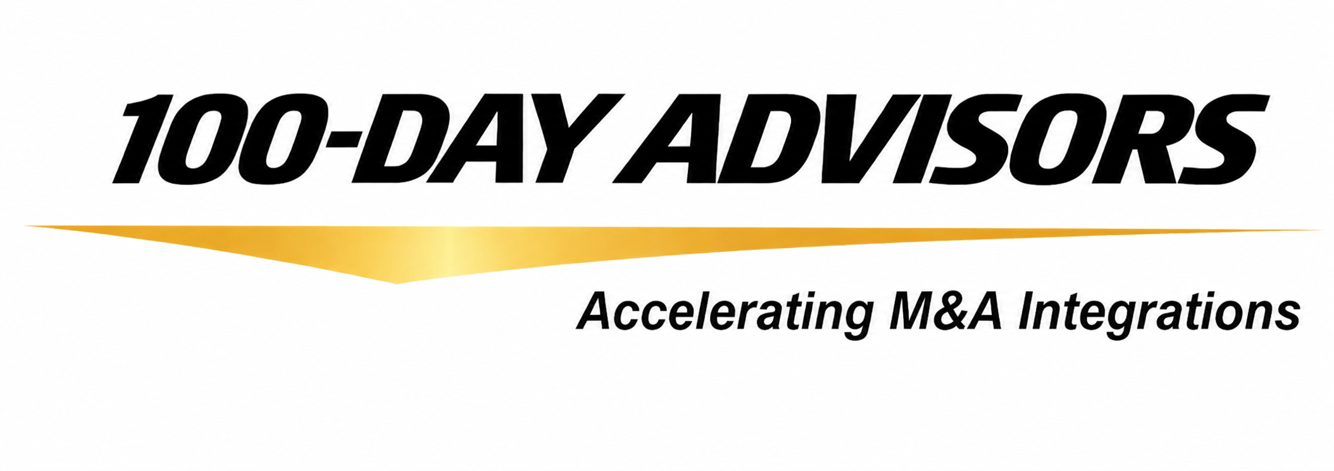


Vendor & Partner End States
Consulting Inquiries:
Email: inquiries@ MandAPlaybook.com
Website: MandAPlaybook.com
8

